Slide 1
TSE6 - OpenCL
Part 4
OpenCL/OpenGL Interoperability

Slide 2
Displaying images
OpenCL has no functions to show images directly on the screen
One way to do it (very inefficient!):
copy the image back to the host,
then the host can put it in a Panel (or other GUI component)
and then the Panel can be shown in a Frame
This means that the image is copied back to the videomemory

Slide 3
OpenGL
Preferably: show images directly from videomemory to screen
Can be done by making OpenCL cooperate with OpenGL
OpenGL is a very advanced standard for generating 3D content
To use this for showing 2D images is like cracking a nut with a sledgehammer
But still the common way to go
Don’t mix them up:
OpenCL: Open Computing Language (API spec; Khronos)
OpenGL: Open Graphics Language (API spec; Khronos)
OpenCV: Open source Computer Vision (Library; OpenCV.org)
OpenMP: Open Multi Processing (API spec; OpenMP ARB)

Slide 4
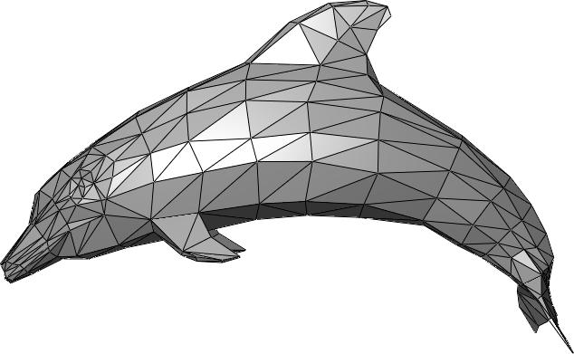
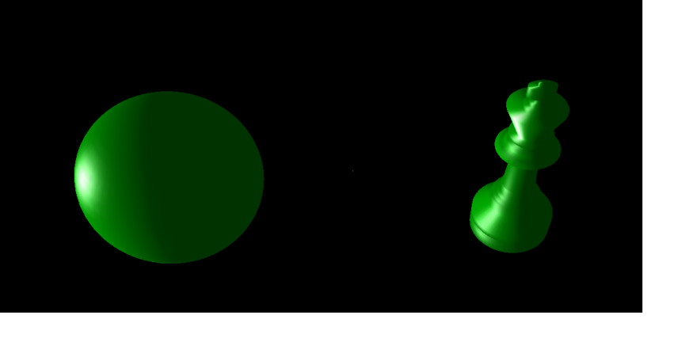
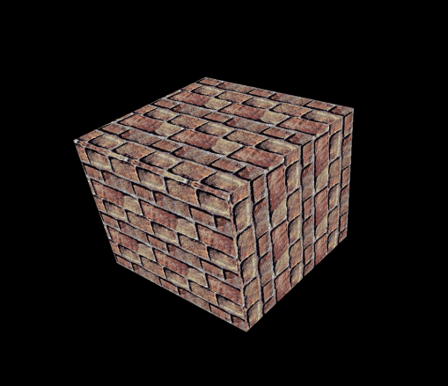
OpenGL basics
OpenGL can create 3D objects, made out of polygons
A polygon is a small triangle or quad
These objects can be transformed
Moved to any location
Rotated
Scaled
Lights can be added, which illuminate the objects
Light can have any color
Objects can have any color
These colors are mixed (yellow light on green object)
Objects can have texture
A texture is just an image, mapped on an object → we will use this!
……

Slide 5
GLUT
OpenGL has no functions to create a window
GLUT is an addition to OpenGL
Provides an easy way to create windows for OpenGL
OpenGL Utility Toolkit
Original version by Mark J Kilgard, but he stopped maintaining it in 2000
Other people created compatible versions, like freeGLUT

Slide 6
Basic GLUT programming
In its simplest form, create a window and OpenGL context with this code (usually at the start of main):
glutInit(&argc, argv); // Initialize GLUT
glutInitWindowSize(WIDTH, HEIGHT); // Define window size
glutCreateWindow("My title"); // Create window with title
glutDisplayFunc( display ); // When the window has to be // redrawn, then function // display will be called
After that, we can do other initialization
At the end of the main function, we start the message loop with:
glutMainLoop();
Handles all events: redraw, mouseclicks, keyclicks, timer, etc
This function ends only when the window is closed

Slide 7
Basic GLUT programming
The function display will be called whenever the window must be redrawn
Contains the OpenGL code for drawing objects and textures
Also, an OpenCL kernel can be called here to update the texture
If we want to redraw the window continuously, then at the end of display we can call
glutPostRedisplay(); // This will request another repaint

Slide 8
Basic GLUT program
#include <GL\freeglut.h>
void display(void) {
//glClear(GL_COLOR_BUFFER_BIT); // Clear screen before drawing new object
glBegin(GL_POLYGON);
glVertex3f(0.0, 0.0, 0.0);
glVertex3f(0.5, 0.0, 0.0);
glVertex3f(0.5, 0.5, 0.0);
glVertex3f(0.0, 0.5, 0.0);
glEnd();
//glFlush(); // Sometimes necessary to flush videobuffer to screen
//glutPostRedisplay(); // Necessary if scene varies over time (animation)
}
int main(int argc, char** argv) {
glutInit(&argc, argv);
//glutInitDisplayMode(GLUT_SINGLE);
glutInitWindowSize(300, 300);
//glutInitWindowPosition(100, 100);
glutCreateWindow("Hello world");
glutDisplayFunc(display);
glutMainLoop();
return 0;
}

Slide 9
Other handlers
If we want to add a key handler, we can do that with:
glutKeyboardFunc(key_func); // function key_func is called at key-press
Similarly, we can add a timer handler:
glutTimerFunc(ms, timer_func, timer_id); // function timer_func is called after // ms milliseconds, specifying the timer_id
Or a mouse handler with glutMouseFunc
Or an ‘idle’ handler with glutIdleFunc (a function that will be called whenever there is nothing else to do
Or …

Slide 10
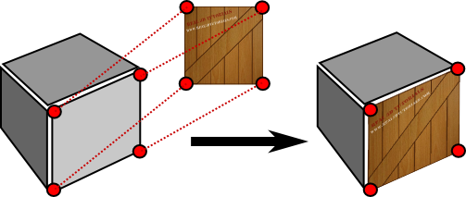
Textures
When OpenGL is combined with OpenCL, we often use textures (because a texture is an image)
2D Texture
Texture mapped on the object
3D object

Slide 11
OpenGL/OpenCL interaction
Initialization steps (done once):
In OpenGL, we create an empty texture (just allocates videomemory)
This texture is converted into an image2d_t in OpenCL
This takes no time; image is not moved or copied
Then repeatedly (in the display function):
Before OpenCL can fill the texture with a kernel, it first has to acquire access
Then the OpenCL kernel is started, which generates the texture image
When the kernel is finished, the texture is released by OpenCL
Finally, OpenGL maps the texture on an object and shows it on the screen
That object can be simply a rectangle (quad)

Slide 12
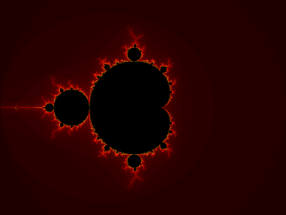
Initialization: OpenGL creates empty texture
glGenTextures(1, &g_texture);
glBindTexture(GL_TEXTURE_2D, g_texture);
glTexParameteri(GL_TEXTURE_2D, GL_TEXTURE_MIN_FILTER, GL_NEAREST);
glTexParameteri(GL_TEXTURE_2D, GL_TEXTURE_MAG_FILTER, GL_NEAREST);
glTexImage2D(GL_TEXTURE_2D, 0, GL_RGBA8, tex_width, tex_height, 0, GL_RGBA, GL_UNSIGNED_BYTE, NULL);
glEnable(GL_TEXTURE_2D);
OpenGL
OpenCL
VideoMemory
Texture

Slide 13
Initialization: OpenCL converts texture into image2d_t
cl_tex = clCreateFromGLTexture2D( context, CL_MEM_WRITE_ONLY, GL_TEXTURE_2D, 0, texture, &err);
OpenGL
OpenCL
VideoMemory
Texture

Slide 14
For every frame: OpenCL acquires access
glFinish();
clEnqueueAcquireGLObjects ( queue, 1, &cl_tex, 0, NULL, NULL );
OpenGL
OpenCL
VideoMemory
Texture

Slide 15
For every frame: OpenCL starts kernel; generates image
clSetKernelArg(...... ,
(void *) &cl_tex); clEnqueueNDRangeKernel(......);
OpenGL
OpenCL
Kernel
VideoMemory
Texture

Slide 16
For every frame: OpenCL releases texture
clEnqueueReleaseGLObjects ( queue, 1, &cl_tex, 0, NULL, NULL );
OpenGL
OpenCL
VideoMemory
Texture

Slide 17

For every frame: OpenGL shows texture mapped on quad
glBegin(GL_QUADS);
glTexCoord2f(0.0f, 0.0f);
glVertex3f(-1.0f, -1.0f, 0.1f);
glTexCoord2f(1.0f, 0.0f);
glVertex3f(1.0f, -1.0f, 0.1f);
glTexCoord2f(1.0f, 1.0f);
glVertex3f(1.0f, 1.0f, 0.1f);
glTexCoord2f(0.0f, 1.0f);
glVertex3f(-1.0f, 1.0f, 0.1f);
glEnd();
OpenGL
OpenCL
VideoMemory
Texture

Slide 18
Typical structure of the display function
void display() {
//Wait until OpenGL is finished using the texture
glFinish();
// Acquire OpenCL access to the texture
clEnqueueAcquireGLObjects(queue, 1, &cl_tex, 0, NULL, NULL);
clSetKernelArg(..., ..., sizeof(cl_mem), (void *)&cl_tex);
clEnqueueNDRangeKernel(......);
// Give the texture back to OpenGL
clEnqueueReleaseGLObjects(queue, 1, &cl_tex, 0, NULL, NULL);
//Wait until object is actually released by OpenCL
clFinish( queue );
// Draw quad, with the texture mapped on it in OPENGL
......
// Request another redisplay of the window
glutPostRedisplay();
}

Slide 19
Some details: Creating a texture in OpenGL
glTexImage2D(GL_TEXTURE_2D, 0, GL_RGBA8, tex_width, tex_height, 0, GL_RGBA, GL_UNSIGNED_BYTE, NULL);
For now, we take most parameters for granted, except:
3^{d} parameter: GL_RGBA8 (internalformat)
This defines how the texture is stored in memory
GL_RGBA8 means 4 bytes per pixel:
Red
Green
Blue
Alpha → Transparency (0 → fully transparent; 1 → not transparent)
Every byte is an unsigned normalized integer:
Short way to store a float value in range [0.0, 1.0]
Float value is calculated as: bytevalue/255
Example: bytevalue 85 actually means 85/255 = 0,3333333

Slide 20
Some details: Creating a texture in OpenGL
glTexImage2D(GL_TEXTURE_2D, 0, GL_RGBA8, tex_width, tex_height, 0, GL_RGBA, GL_UNSIGNED_BYTE, NULL);
4th and 5th parameter: width and height of the texture in pixels
Total size of this texture in memory?
tex_width*tex_height*4
How is a yellow pixel stored?
(1.0, 1.0, 0.0, 1.0) → (in hex: FF FF 00 FF)

Slide 21
Some details: Converting a texture to OpenCL
cl_mem cl_tex = clCreateFromGLTexture2D(context, CL_MEM_WRITE_ONLY, GL_TEXTURE_2D, 0, texture, &err);
Note: in later versions, this function is called clCreateFromGLTexture
The OpenCL context which is used here must be created with some extra properties, to make cooperation with OpenGL possible
cl_context_properties properties[] = { CL_GL_CONTEXT_KHR, reinterpret_cast<cl_context_properties>(wglGetCurrentContext()), CL_WGL_HDC_KHR, reinterpret_cast<cl_context_properties>(wglGetCurrentDC()), 0 }; // Create the OpenGL context context = clCreateContext(properties, 1, &device, NULL, NULL, &err);

Slide 22
Some details: Converting a texture to OpenCL
cl_mem cl_tex = clCreateFromGLTexture2D(context, CL_MEM_WRITE_ONLY, GL_TEXTURE_2D, 0, texture, &err);
2nd parameter: CL_MEM_WRITE_ONLY
Meaning is obvious: OpenCL can only write to this texture

Slide 23
Some details: Converting a texture to OpenCL
cl_mem cl_tex = clCreateFromGLTexture2D(context, CL_MEM_WRITE_ONLY, GL_TEXTURE_2D, 0, texture, &err);
Return type: cl_mem
A 2D image is returned
Note: this is different from a cl_mem returned by clCreateBuffer
This image uses the same internal format as the texture
Remember: 4 bytes per pixel (RGBA) and every byte is an unsigned normalized integer (actually a float in 1 byte)
In the kernel, this has to be an argument of type image2d_t
(A cl_mem returned by clCreateBuffer is a pointer in the kernel)
This argument must be either __write_only or __read_only

Slide 24
How to write pixels in an image2d_t?
Suppose my_image is an image2d_t
We can write yellow to pixel (x,y) into my_image as follows:
int2 coord = (int2)(x, y); float4 color_yellow = (1.0, 1.0, 0.0, 1.0); write_imagef(my_image, coord, color_yellow );

Slide 25
2 types of cl_mem
cl_mem cbbuffer = clCreateBuffer(......); clKernelArgs(kernel1, 0, sizeof(cl_mem), (void *)&cbbuffer); clEnqueuNDRangeKernel(......);
In the kernel: __kernel void kernel1(__global mandelbrot_color *buffer,) { ... buffer[x,y] = ...; ...; }

Slide 26
2 types of cl_mem
cl_mem txbuffer = clCreateFromGLTexture2D (......); clKernelArgs(kernel1, 0, sizeof(cl_mem), (void *)&txbuffer); clEnqueuNDRangeKernel(......);
In the kernel: __kernel void kernel1(__write_only image2d_t buffer,) { ... write_imagef(buffer, ......); ...; }

Slide 27
Useful links
A document from Intel, describing some of the steps needed for OpenCL/OpenGL cooperation: https://software.intel.com/sites/default/files/managed/da/ab/OpenGLInterop.pdf
A tutorial for a simple GLUT example, much like the one that is used in the assignment: http://peon-developments.blogspot.nl/2011/04/creating-opengl-window-with-freeglut-in.html
The full GLUT specs: https://www.opengl.org/resources/libraries/glut/spec3/spec3.html

